Slide 1
ADT
CSC1003

Slide 2
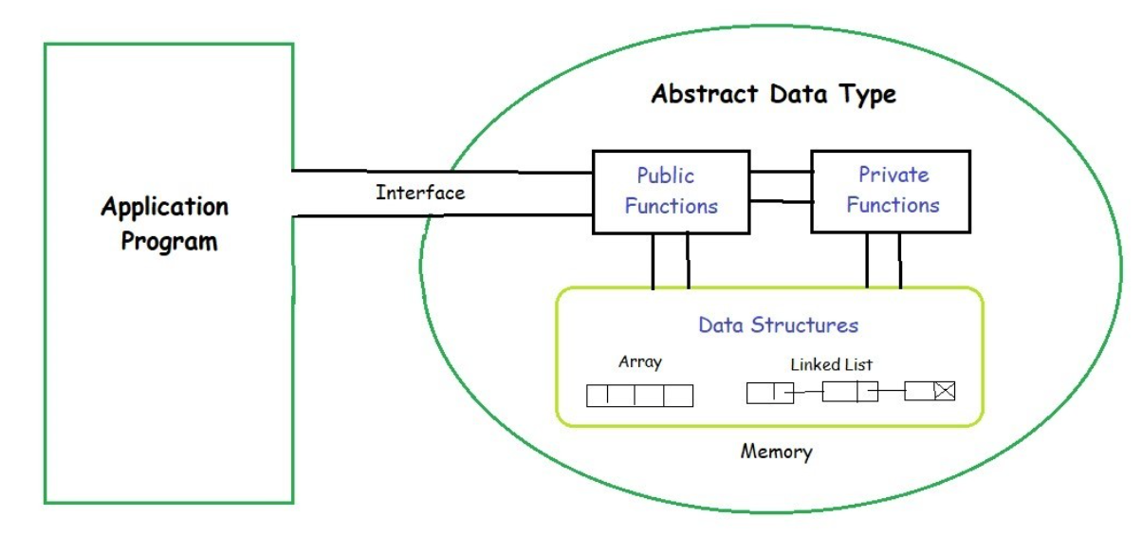
Brief Review
ADT: A data type is a set of values and a set of operations on those values.

Slide 3
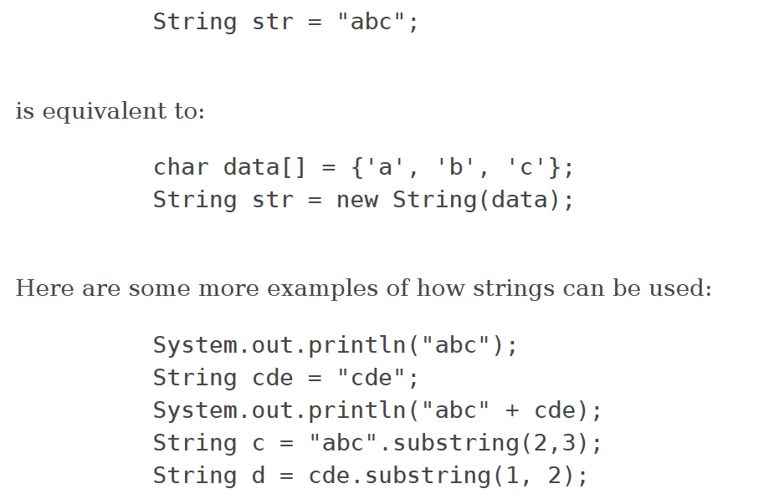
JAVA String:
The String class represents character strings. All string literals in Java programs, such as "abc", are implemented as instances of this class.
Strings are constant; their values cannot be changed after they are created. String buffers support mutable strings. Because String objects are immutable they can be shared.

Slide 4
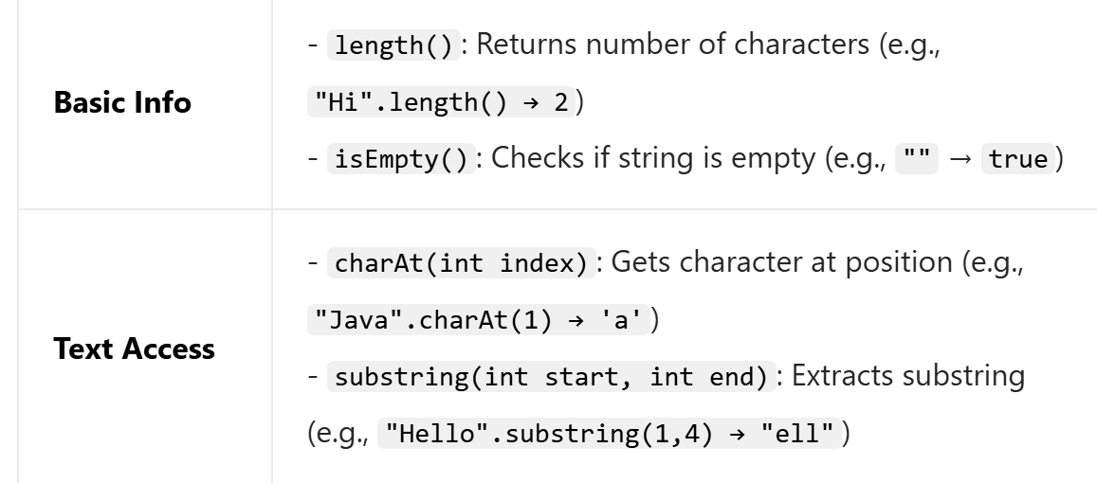
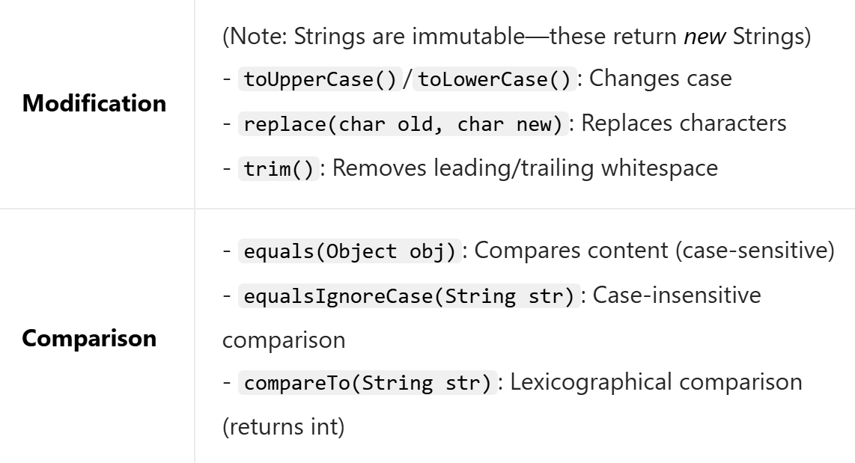
String:
Functions of strings:

Slide 5
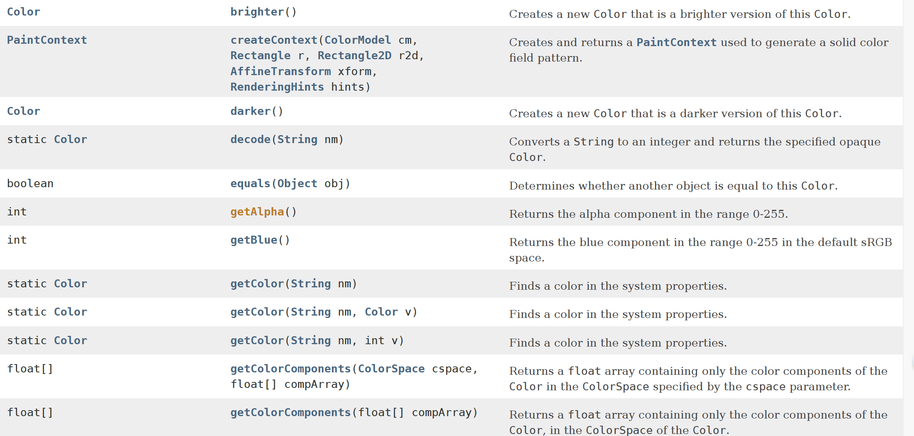
Color
The Color class is used to encapsulate colors in the default sRGB color space.
Here are a lot of extra functions of Color.

Slide 6
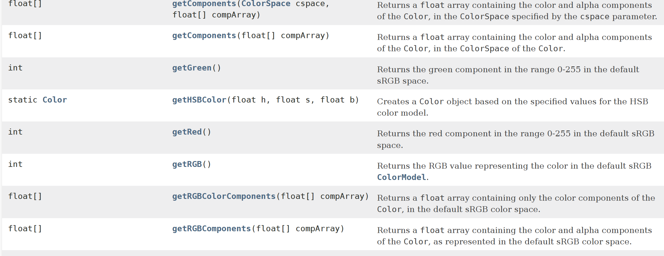
Color

Slide 7
Picture
The Picture data type provides a basic capability for manipulating the individual pixels of an image. You can either create a blank image (of a given dimension) or read an image in a supported file format (typically JPEG, PNG, GIF, TIFF, and BMP). This class also includes methods for displaying the image in a window and saving it to a file.
More introductions are in the link Picture.

Slide 8
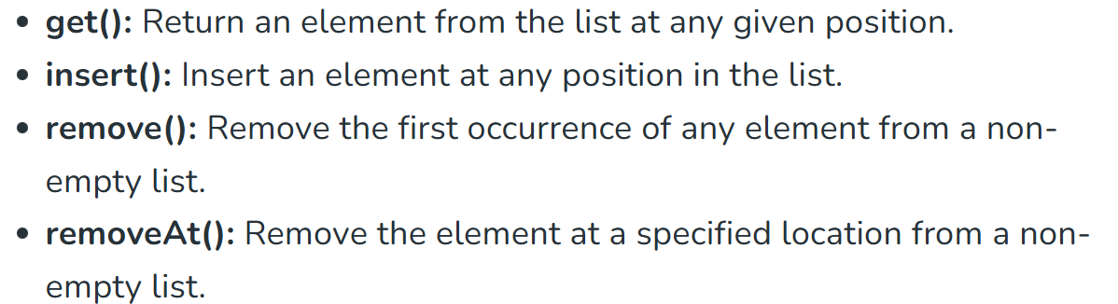
ADT: List
Implement an ADT which contains an array and can achieve the following functions(every function’s Worst-Case Time Complexity is O(N) for a single use, and the max length of the array is 1000. At the beginning the list is empty.) :

Slide 9
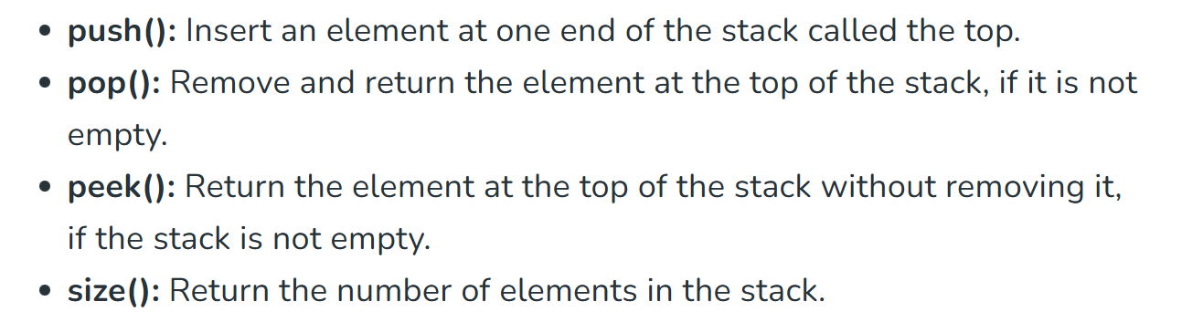
ADT: Stack
The Stack ADT is a linear data structure that follows the LIFO (Last In, First Out) principle. It allows elements to be added and removed only from one end, called the top of the stack. Please implement it(every function’s Worst-Case Time Complexity is O(1) for a single use, and the max length of the array is 1000.At the beginning, the stack is empty).

Slide 10
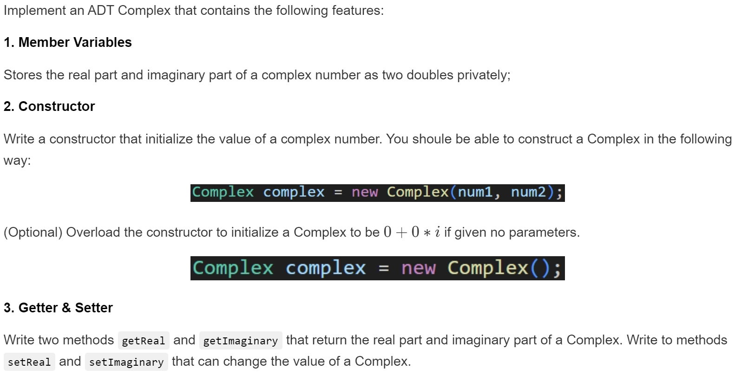
ADT: Complex

Slide 11
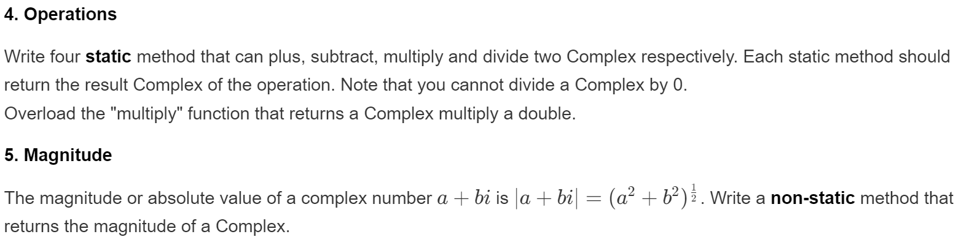
ADT: Complex

